Slide 1
Lecture 5-6 Object Detection – Boosting
Tae-Kyun Kim

Slide 2
Face Detection Demo

Slide 3
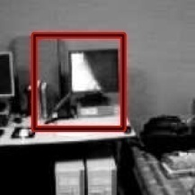

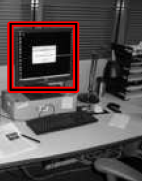
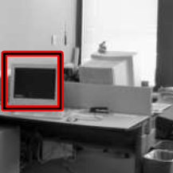
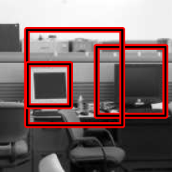
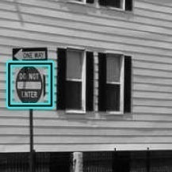
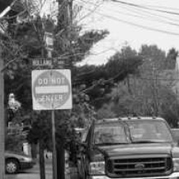
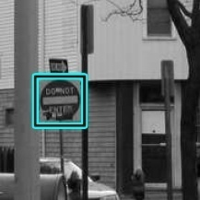

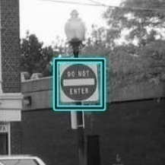
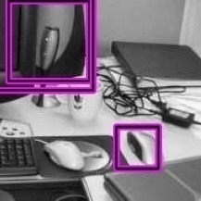
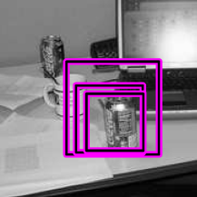
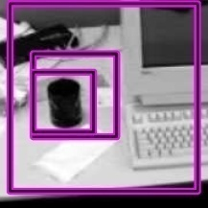
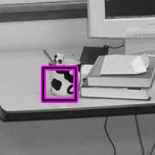
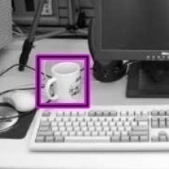
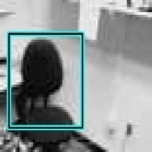

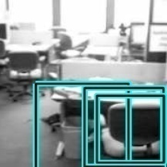
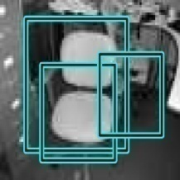

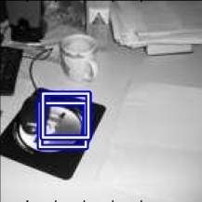
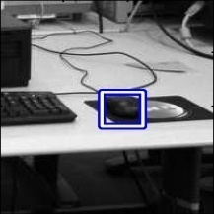
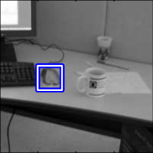
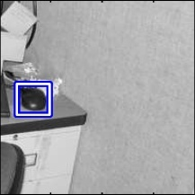
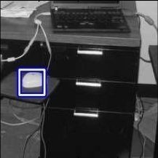
Multiclass object detection [Torralba et al PAMI 07]
A boosting algorithm, originally for binary class problems, has been extended to multi-class problems.

Slide 4
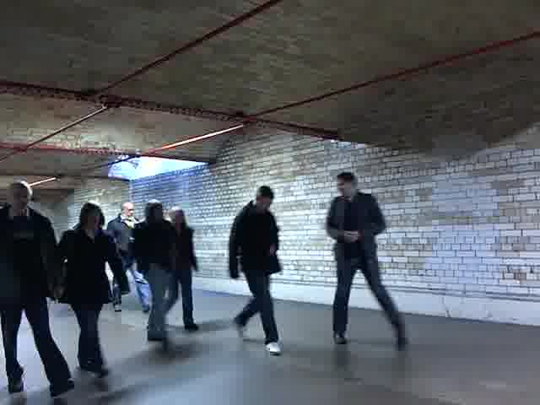
Object Detection
Input: A single image is given as input, without any prior knowledge.

Slide 5
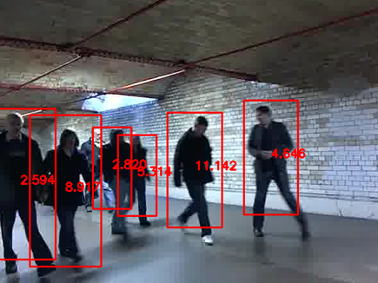
Object Detection
Output is a set of tight bounding boxes (positions and scales) of instances of a target object class (e.g. pedestrian).

Slide 6
Object Detection
Scanning windows: We scan every scale and every pixel location in an image.

Slide 7
Number of Hypotheses
It ends up with a huge number of candidate windows .
x
…
# of scales
# of pixels
Number of Windows: e.g. 747,666

Slide 8
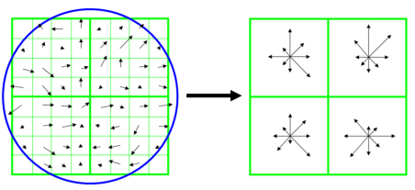
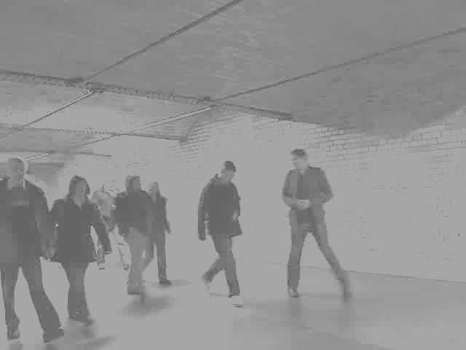
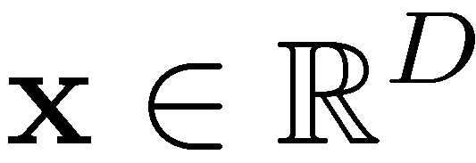

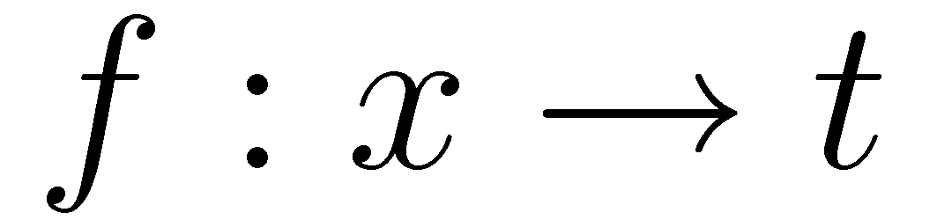
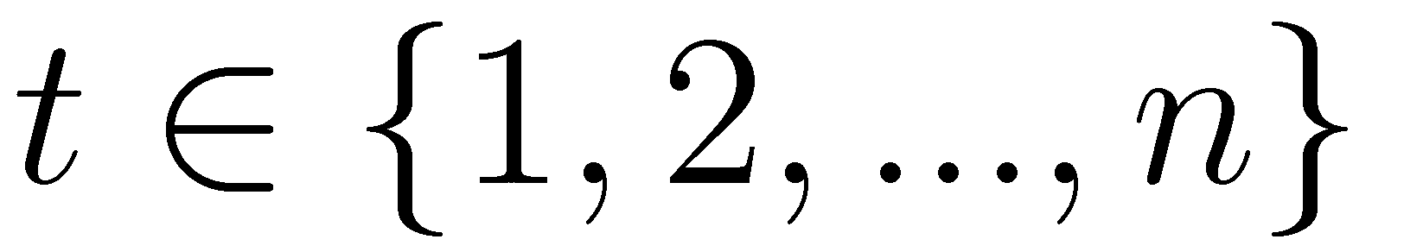
Time per window
What amount of time is given to process a single scanning window?
SIFT
or raw pixels
……
…
dimension D
Num of feature vectors: 747,666
Classification:

Slide 9
Time per window
or raw pixels
……
…
dimension D
Num of feature vectors: 747,666
In order to finish the task say in 1 sec
Time per window (or vector):
0.00000134 sec
Neural Network?
Nonlinear SVM?

Slide 10
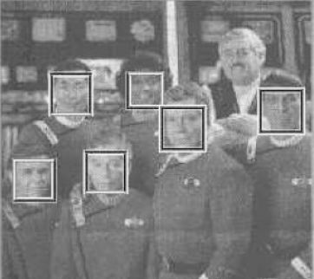
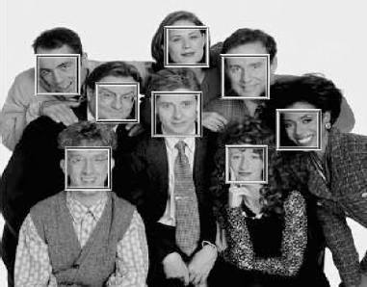
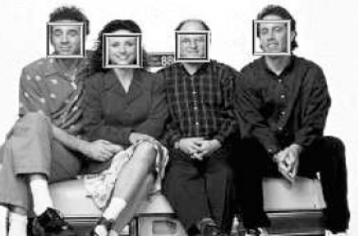
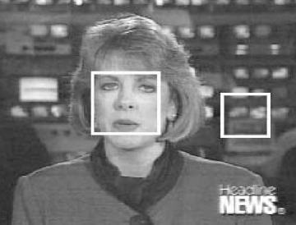
Examples of face detection
From Viola, Jones, 2001

Slide 11
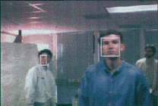
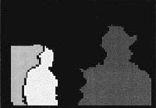
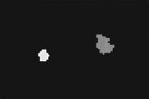
More traditionally… The search space is narrowed down.
By Integrating Visual Cues [Darrell et al IJCV 00].
Face pattern detection output (left).
Connected components recovered from stereo range data (mid).
Regions from skin colour (hue) classification (right).

Slide 12
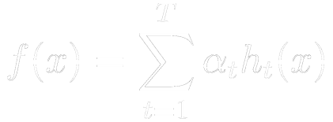


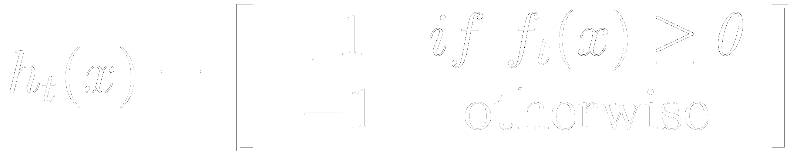
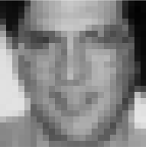

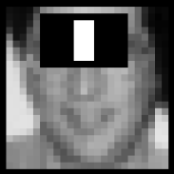
Since about 2001 (Viola &Jones 01)… “Boosting Simple Features” has been a dominating art.
Adaboost classification
Weak classifiers: Haar-basis features/functions
The feature pool size is e.g. 45,396 (>>T)
Strong classifier
Weak classifier

Slide 13
Introduction to Boosting Classifiers - AdaBoost (Adaptive Boosting)

Slide 14
Boosting
Boosting gives good results even if the base classifiers have a performance slightly better than random guessing.
Hence, the base classifiers are called weakclassifiers or weaklearners.

Slide 15
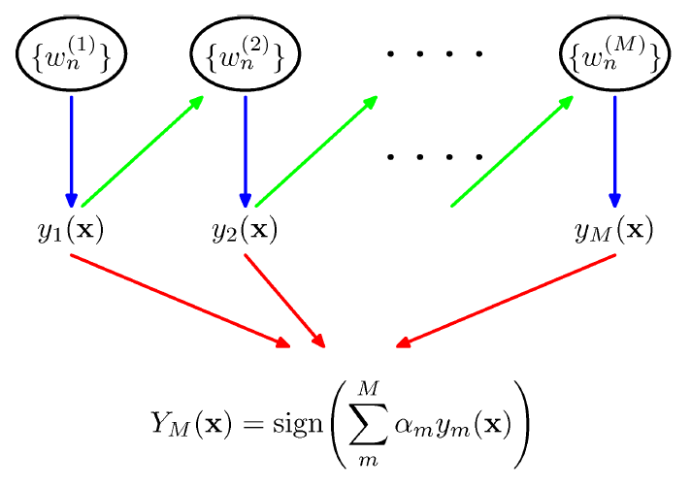
Boosting
For a two (binary)-class classification problem, we train with
training data x_{1,…,} x_{N}
target variables t_{1,…,} t_{N}, where t_{N} ∈ {-1,1},
data weight w_{1,…,} w_{N}
weak (base) classifier candidates y(x) ∈ {-1, 1}.

Slide 16
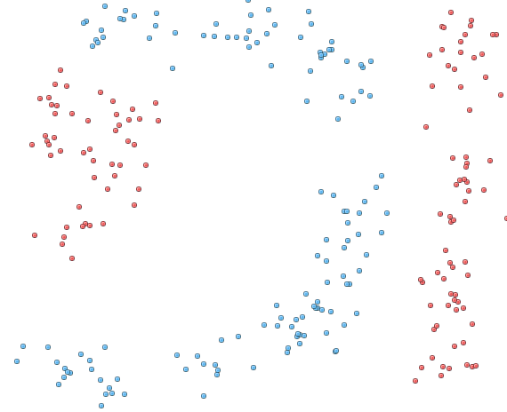
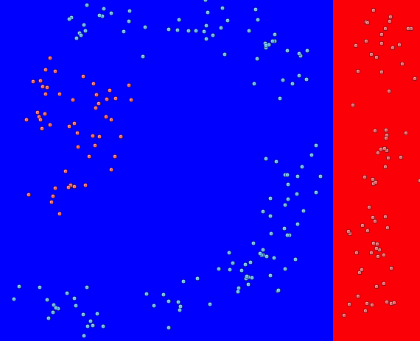
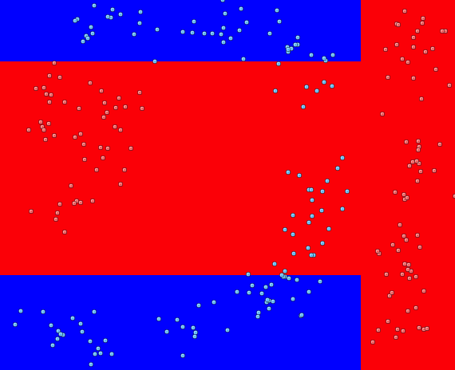
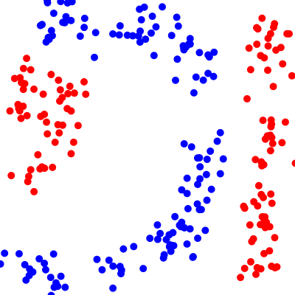
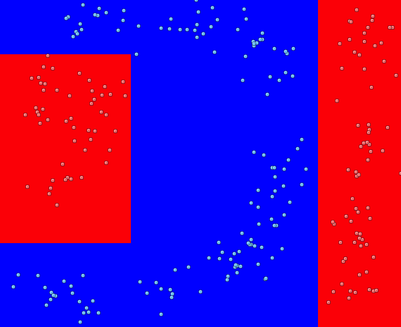
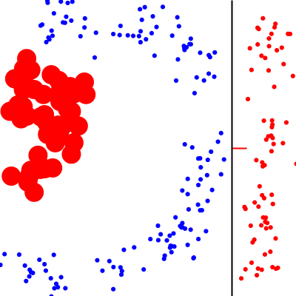
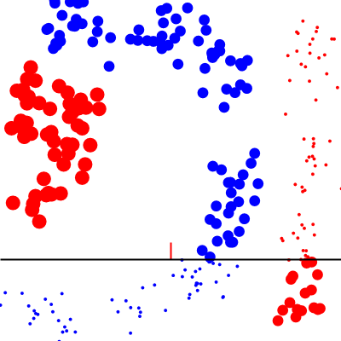
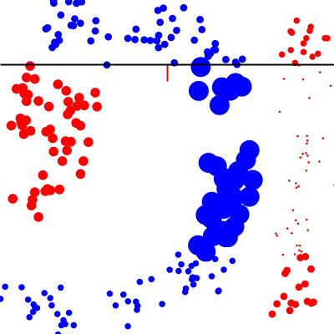
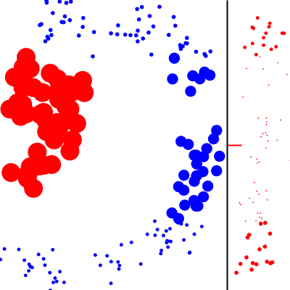
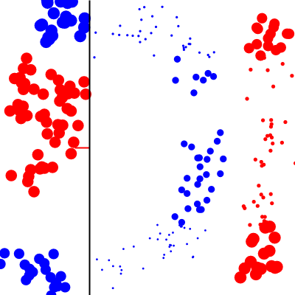


Boosting does
Iteratively,
1) reweighting training samples,
by assigning higher weights to previously misclassified samples,
2) finding the best weakclassifier for the weighted samples.
50 rounds
2 rounds
3 rounds
4 rounds
5 rounds
1 round

Slide 17
In the previous example, the weaklearner was defined by a horizontal or vertical line, and its direction.
-1
+1

Slide 18


AdaBoost (adaptive boosting)
1. Initialise the data weights {w_{n}} by w_{n}⁽¹⁾ = 1/N for n = 1,… ,N.
2. For m = 1, … ,M
: the number of weak classifiers to choose
(a) Learn a classifier y_{m}(x) that minimises the weighted error, among all weak classifier candidates
where I is the impulse function.
(b) Evaluate

Slide 19



and set
(c) Update the data weights
3. Make predictions using the final model by

Slide 20






Boosting

Slide 21
Boosting as an optimisation framework

Slide 22


Minimising Exponential Error
AdaBoost is the sequential minimisation of the exponential error function
where t_{n} ∈ {-1, 1} and f_{m}(x) is a classifier as a linear combination of base classifiers y_{l}(x)
We minimise E with respect to the weight α_{l} and the parameters of the base classifiers y_{l}(x).

Slide 23


Sequential Minimisation: suppose that the base classifiers y₁(x) ,. …, y_{m-1}(x) and their coefficients α₁, …, α_{m-1} are fixed, and we minimise only w.r.t. a_{m} and y_{m}(x).
The error function is rewritten by
where w_{n}^{(m)} = exp{−t_{n} f_{m-1} (x_{n})} are constants.

Slide 24



Denote the set of data points correctly classified by y_{m}(x_{n}) by T_{m}, and those misclassified M_{m} , then
When we minimise w.r.t. y_{m}(x_{n}), the second term is constant and minimising E is equivalent to

Slide 25








By setting the derivative w.r.t. α_{m} to 0, we obtain
where
From
As
The term exp(-α_{m}/2) is independent of n, thus we obtain

Slide 26

Exponential Error Function
Pros: it leads to simple derivations of Adaboost algorithms.
Cons: it penalises large negative values. It is prone to outliers.
The exponential (green)
rescaled cross-entropy (red)
hinge (blue), and misclassification (black)
error ftns.

Slide 27





Existence of weaklearners
Definition of a baseline learner
Data weights:
Set
Baseline classifier: for all x
Error is at most ½.
Each weaklearner in Boosting is required s.t.
Error of the composite hypothesis goes to zero as boosting rounds increase [Duffy et al 00].

Slide 28
Robust real-time object detector Viola and Jones, CVPR 01 http://www.iis.ee.ic.ac.uk/icvl/mlcv/viola_cvpr01.pdf

Slide 29
Boosting Simple Features [Viola and Jones CVPR 01]
Adaboost classification
Weak classifiers: Haar-basis like functions (45,396 in total feature pool)
Strong classifier
Weak classifier
……
24
pixels
24 pixels

Slide 30

Learning (concept illustration)
Resized to 24x24
Resized to 24x24
Non-face images
Face images
Output:
weaklearners

Slide 31

Evaluation (testing)
The learnt boosting classifier i.e. is applied to every scan-window.
The response map is obtained, then non-local maxima suppression is performed.
Non-local maxima suppression

Slide 32
Receiver Operating Characteristic (ROC)
Boosting classifier score (prior to the binary classification) is compared with a threshold.
The ROC curve is drawn by the false negative rate against the false positive rate at various threshold values:
False positive rate (FPR) = FP/N
False negative rate (FNR) = FN/P
where P positive instances,
N negative instances,
FP false positive cases, and
FN false negative cases.
> Threshold
Class 1 (face)
< Threshold
Class -1 (no face)
1
FNR
0
FPR
1

Slide 33
How to accelerate the boosting training and evaluation

Slide 34



Integral Image
A value at (x,y) is the sum of the pixel values above and to the left of (x,y).
The integral image can be computed in one pass over the original image.

Slide 35

Boosting Simple Features [Viola and Jones CVPR 01]
Integral image
The sum of original image values within the rectangle can be computed: Sum = A-B-C+D
This provides the fast evaluation of Haar-basis like features
1
2
3
4
5
6
(6-4-5+3)-(4-2-3+1)

Slide 36
Evaluation (testing)
x
y
ii(x,y)
*In the coursework2, you can first crop image windows, then compute the integral images of the windows, than of the entire image.

Slide 37
Boosting as a Tree-structured Classifier

Slide 38






Boosting (very shallow network)
The strong classifier H as boosted decision stumps has a flat structure
Cf. Decision “ferns” has been shown to outperform “trees” [Zisserman et al, 07] [Fua et al, 07]
x
……
……
c0 c1
c0 c1
c0 c1
c0 c1
c0 c1
c0 c1

Slide 39


Boosting -continued
Good generalisation is achieved by a flat structure.
It provides fast evaluation.
It does sequential optimisation.
A strong boosting classifier
A strong boosting classifier
Boosting Cascade [viola & Jones 04], Boosting chain [Xiao et al]
It is very imbalanced tree structured.
It speeds up evaluation by rejecting easy negative samples at early stages.
It is hard to design
T = 2
5
10
20
50
100
……

Slide 40



A cascade of classifiers
The detection system requires good detection rate and extremely low false positive rates.
False positive rate and detection rate are
fi is the false positive rate of i-th classifier on the examples that get through to it.
The expected number of features evaluated is
pj is the proportion of windows input to i-th classifier.

Slide 41

Demo video: Fast evaluation

Slide 42










Object Detection by a Cascade of Classifiers
It speeds up object detection by coarse-to-fine search.
Romdhani et al. ICCV01

